Slide 1
SECURITY AWARENESS TRAINING

Slide 2
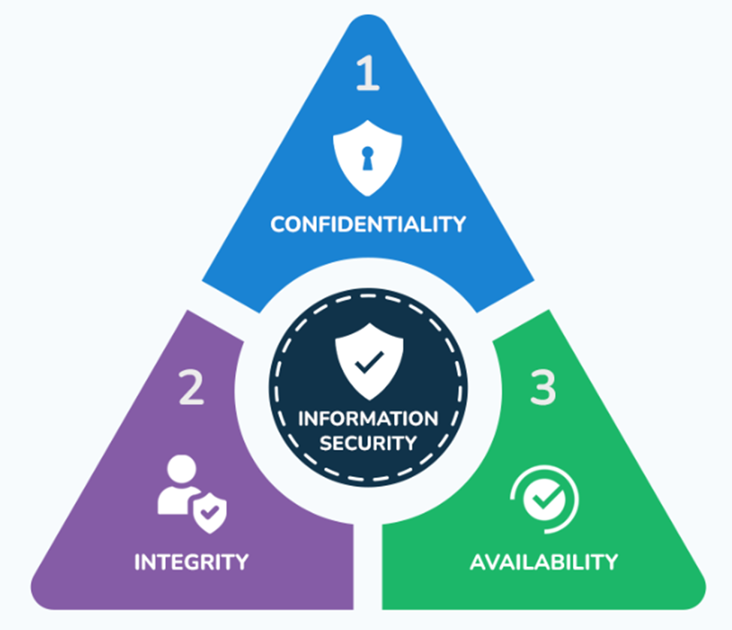
FUNDAMENTALS
Cybersecurity - Practices, processes, and controls used to protect information, systems, and services from unauthorized access, disruption, or misuse.
It is important to have awareness as human beings are the weakest factor when it comes to security.

Slide 3
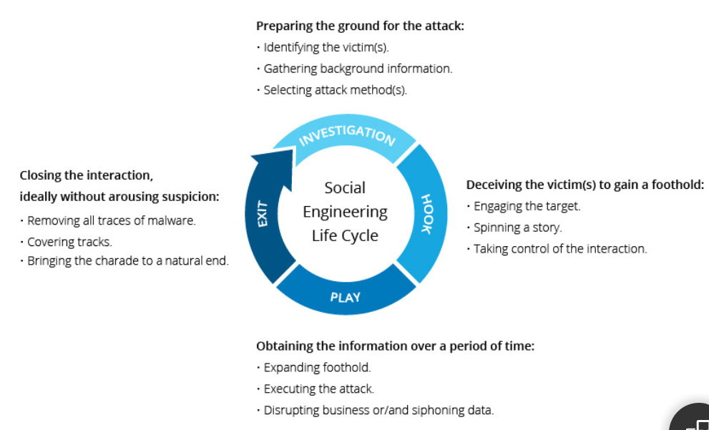
SOCIAL ENGINEERING & PHISHING
Social Engineering – Psychological manipulation used to trick user into exposing confidential data or performing risk action that compromise an organization’s security defenses
Phishing – Form of social engineering where an attacker impersonates a trusted entity and uses text or voice to obtain sensitive information

Slide 4
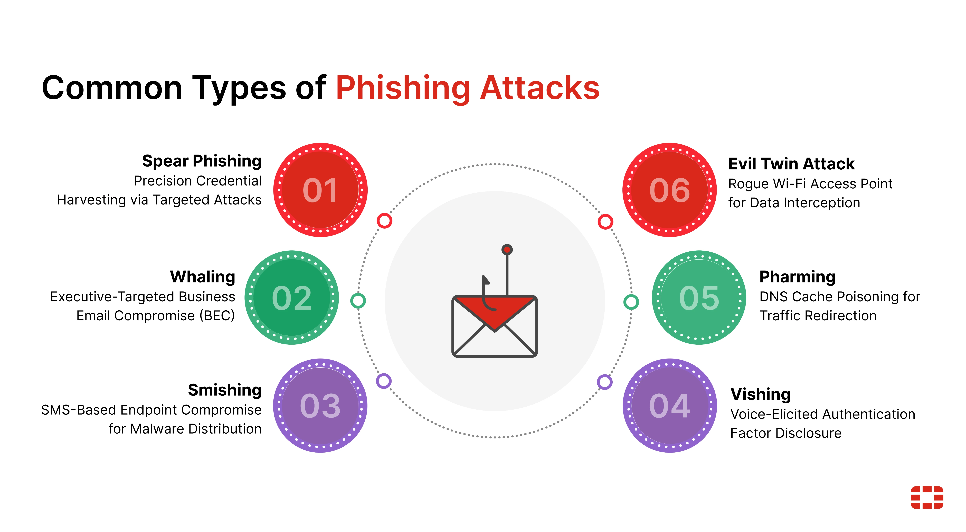
PHISHING
Why phishing works
Urgency – “Act now or there will be consequences or loss”
Authority – “ From your manager”
Fear – “ Consequences of inaction”
Curiosity – “Click the link below for more”
Reasons for phishing
Credential Theft
Malware Delivery
Data Exfiltration
Financial Fraud
How to identify phishing attacks
Examine the sender address if via email
Unexpected requests
Request for confidential information i.e. passwords
Sense of urgency
Check grammar and spelling errors

Slide 5
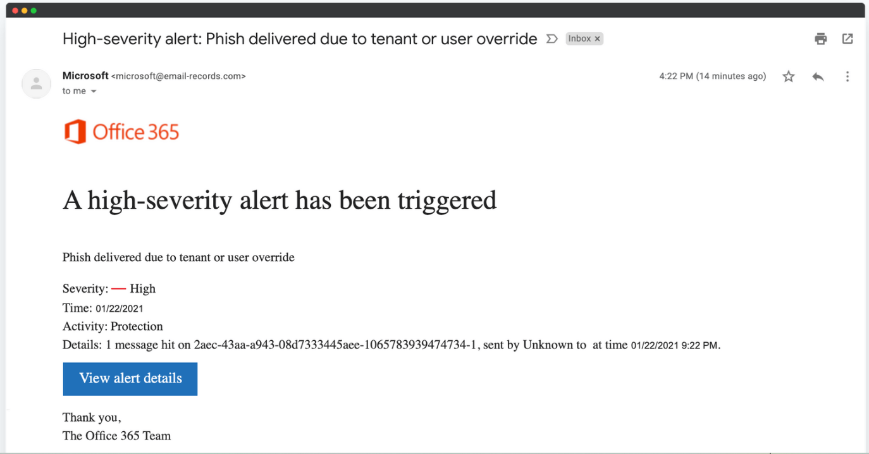
Example of a phishing attack
Red Flags
The sender email address. The domain is not from Microsoft or the company.
The view details link inciting curiosity to click
Sense of urgency – Subject: High-Severity alert

Slide 6
ACTIONS
Do not click on any links or hover over them with your mouse.
Do not open any attachments, as they may contain malware.
Do not reply to the sender or call any phone numbers provided in the email.
Do not forward the email to colleagues
Report the email to your IT department immediately
Delete the email
If you accidentally clicked on the link or opened an attachment, disconnect your device from the network and notify the IT department immediately. Do not switch off the machine.

Slide 7
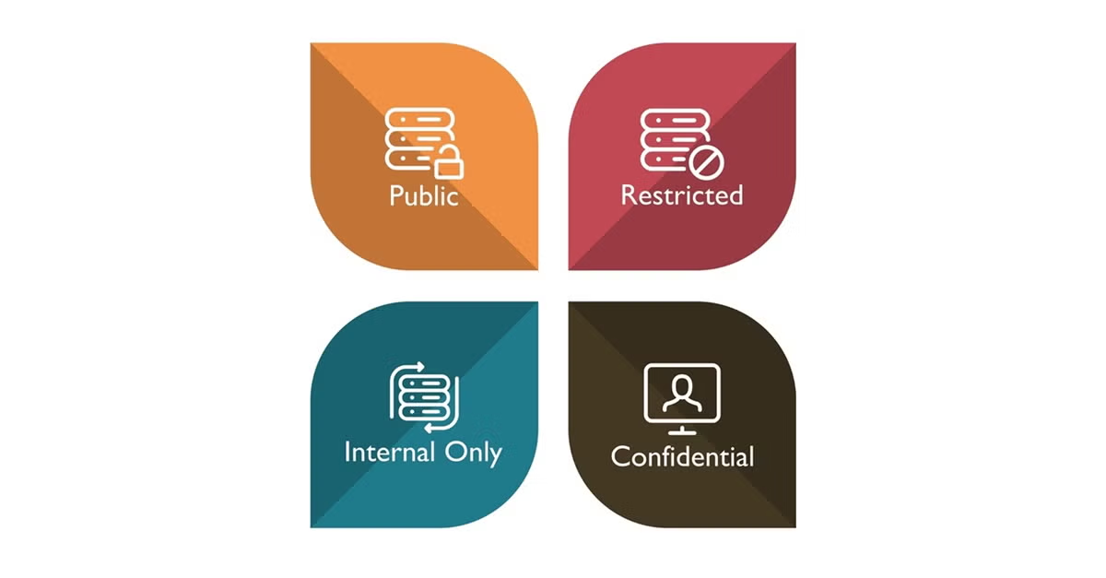
Data Protection & Information Handling
Data Classification- Process of analyzing &categorizing data based on sensitivity, value and risk to apply appropriate security, governance and compliance measures.
Data Classification levels:
  Public – safe to share externally
  Internal – for staff use only
  Confidential – limited access, business-critical
  Restricted / Highly Sensitive – strict controls
Data should be processed based on the organization’s data classification policy to prevent incidents

Slide 8
Data
Personal data – Any information that can be used to identify a person i.e. Name , ID number, email addresses
Sensitive data – Type of personal data that is highly private and protected due to high risk of harm if exposed. i.e. Financial data, Health data, Biometrics, Criminal record

Slide 9
Data Handling Best Practices
Share and process data based on policy
Use approved systems only – No personal apps
Clean desk policy
Lock screens
Proper disposal
Verify requests before sharing data

Slide 10
Incident Awareness & Reporting
Incident – Any event that can compromise the confidentiality, integrity or availability of an organization's information or information systems
Examples:
  Opening a malicious attachment or link
  Exposure of confidential data
  Lost or stolen organization devices
  Suspicious system behavior i.e. pop-ups, strange messages

Slide 11
ACTIONS
If an incident occurs:
1. Stop – Don’t click, reply, or fix it yourself. Disconnect your machine from the network.
2. Preserve – Leave emails, files, or messages intact. Do not switch off your machine.
3. Report – Use the official reporting channel immediately. Report to IT department.
4. Follow instructions – Cooperate with the response team. Give as much information as possible to aid in the investigation.
5. Do not share – Avoid discussing the incident externally.

Slide 12
Q & A
NEVER SHARE YOUR PASSWORD WITH ANYONE

